Slide 1

Constantin Monica - Andreea
Popa Oana - Maria
Ruieneanu Dorian

Slide 2
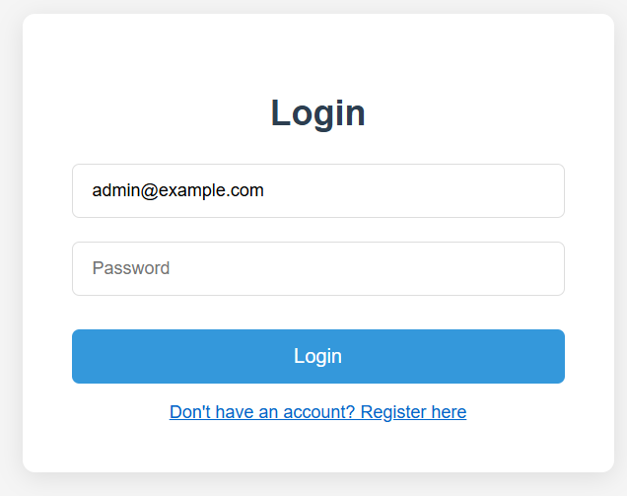
Login page
The page is available for all types of users.
It has the "Login" button that redirects the user to a different dashboard page depending on the role of the user.
The user can also register if it doesn’t already have an account.

Slide 3
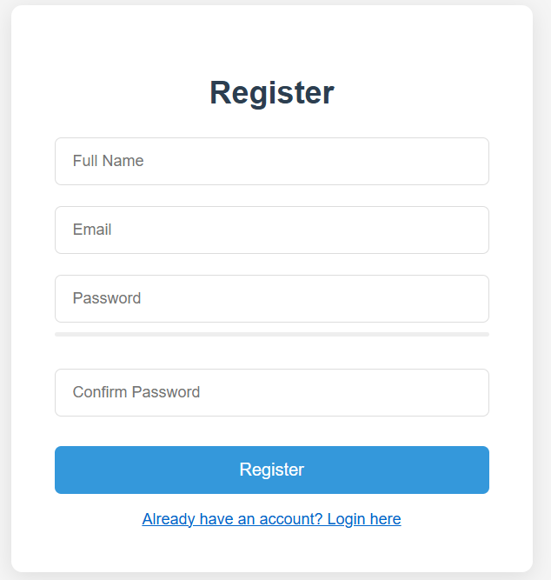
Register Page
The register page provides text boxes for the user to fill with the profile information and also present a link to the login page if he already has an account.

Slide 4
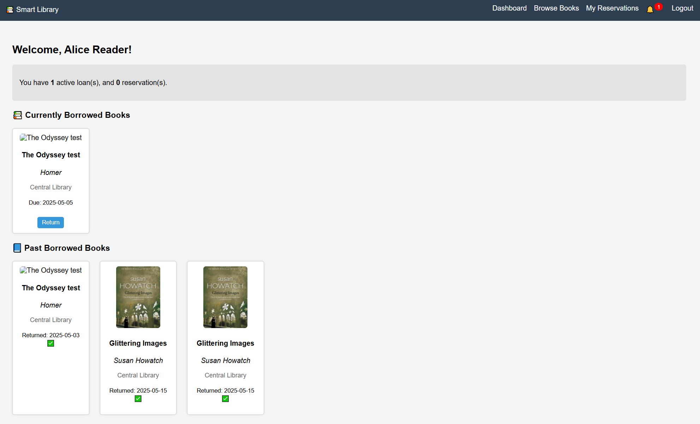
Reader Dashboard
The reader dashboard provides general information on currently borrowed books , previously borrowed books and also notifications about active reservations.

Slide 5
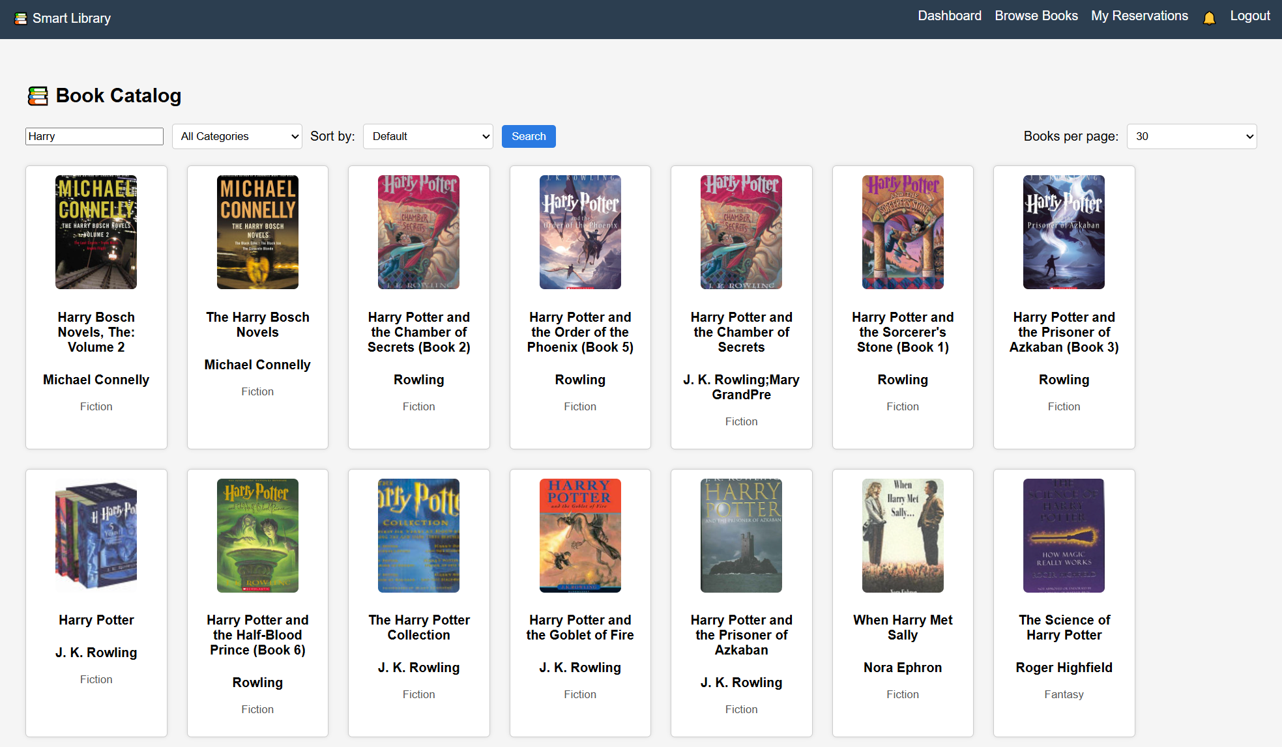
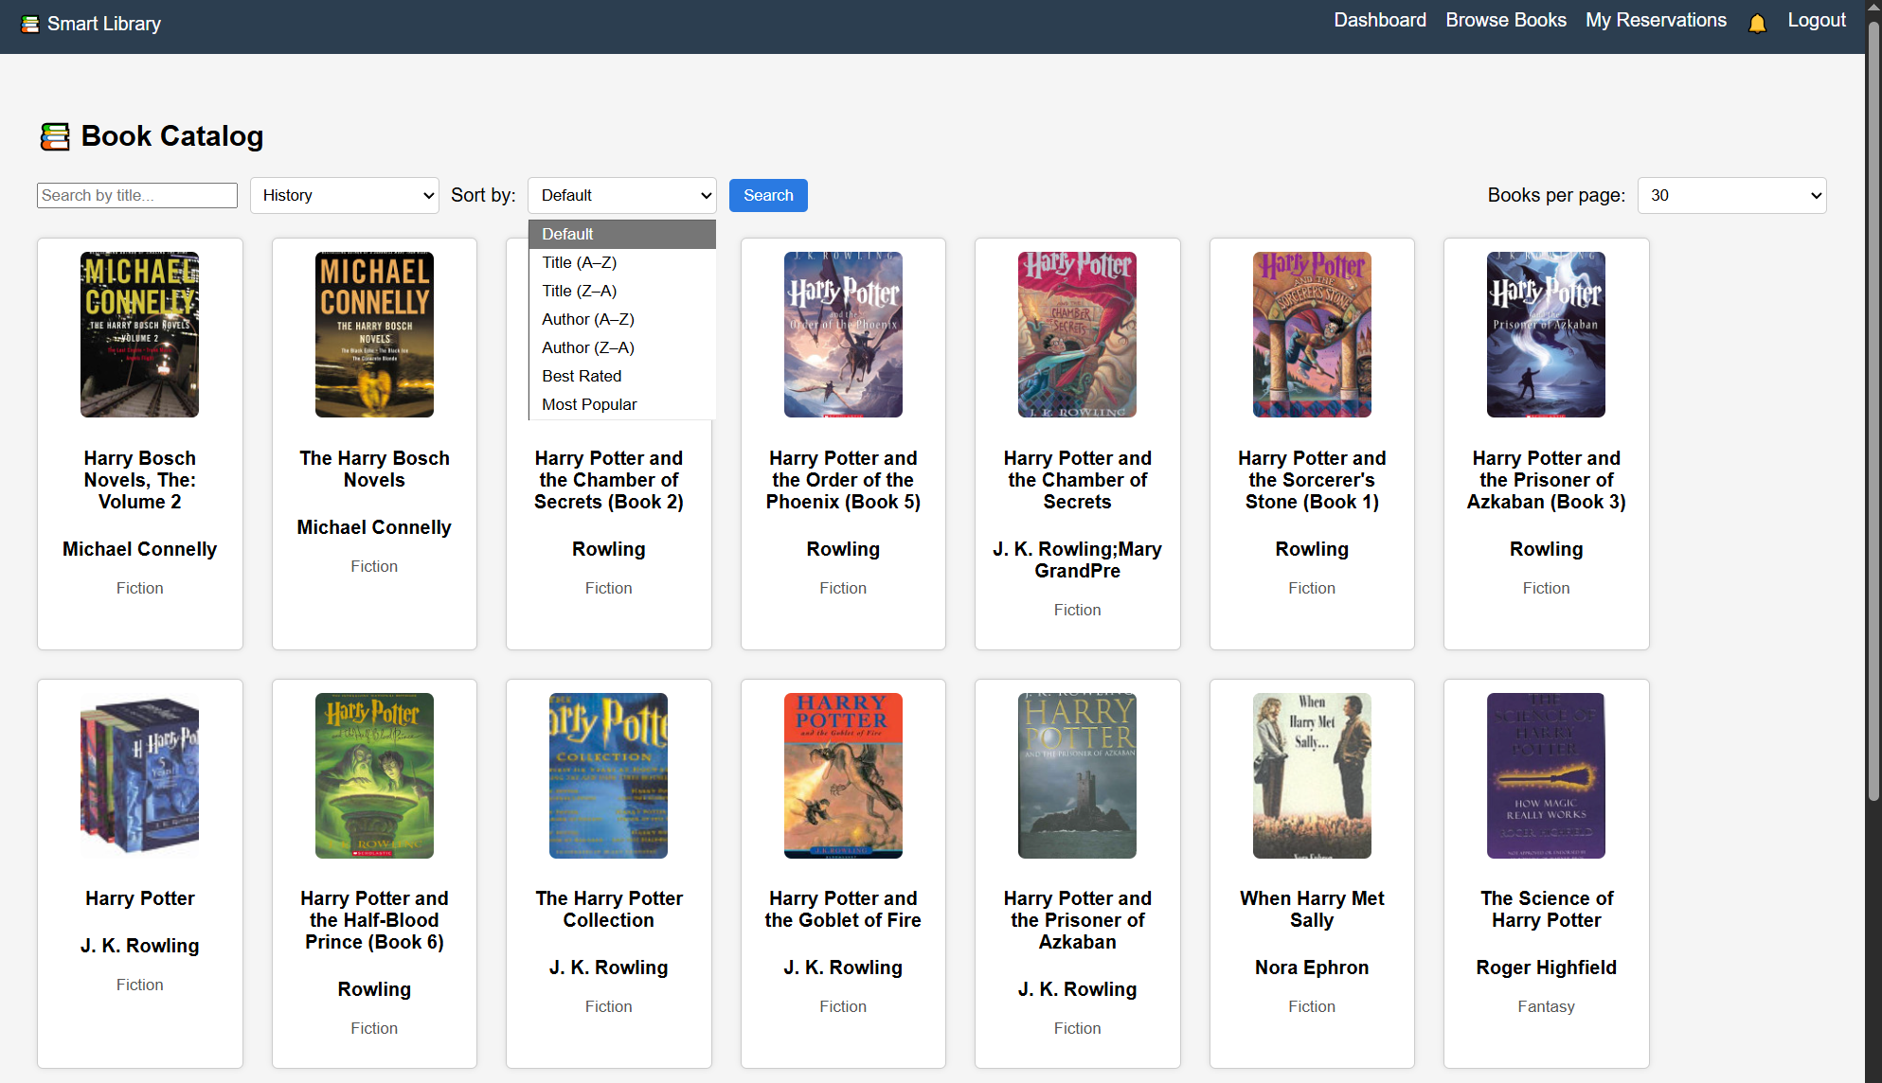
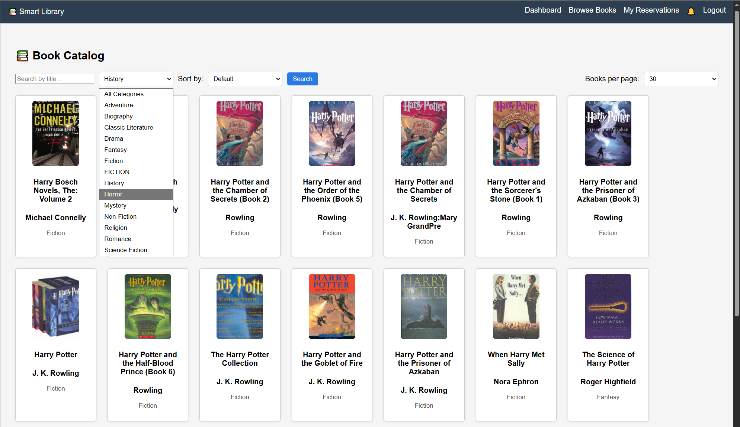
Book Catalog
Book Catalog for Reader allows the user to search for a certain book using either the title or filtering based on categories , rating , as well as choosing how many books per page to display.

Slide 6
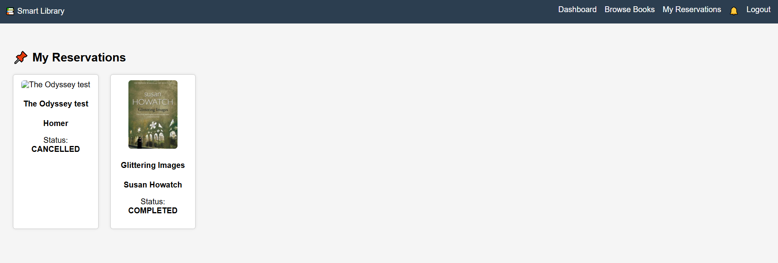
Reservations page
The reservations page for the reader provides information about the currently reserved books and their status. The reader can also see his previous reservations.

Slide 7
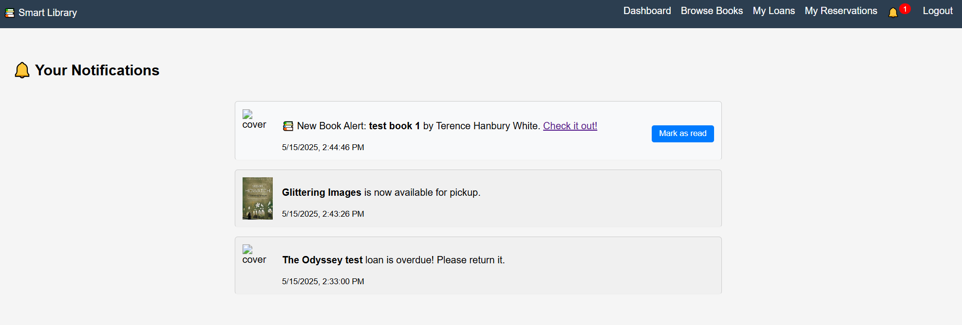
Notifications page
The Notifications page show information about loans that are overdue , reserved books that are now allowed for pick up and new book received by the library.

Slide 8
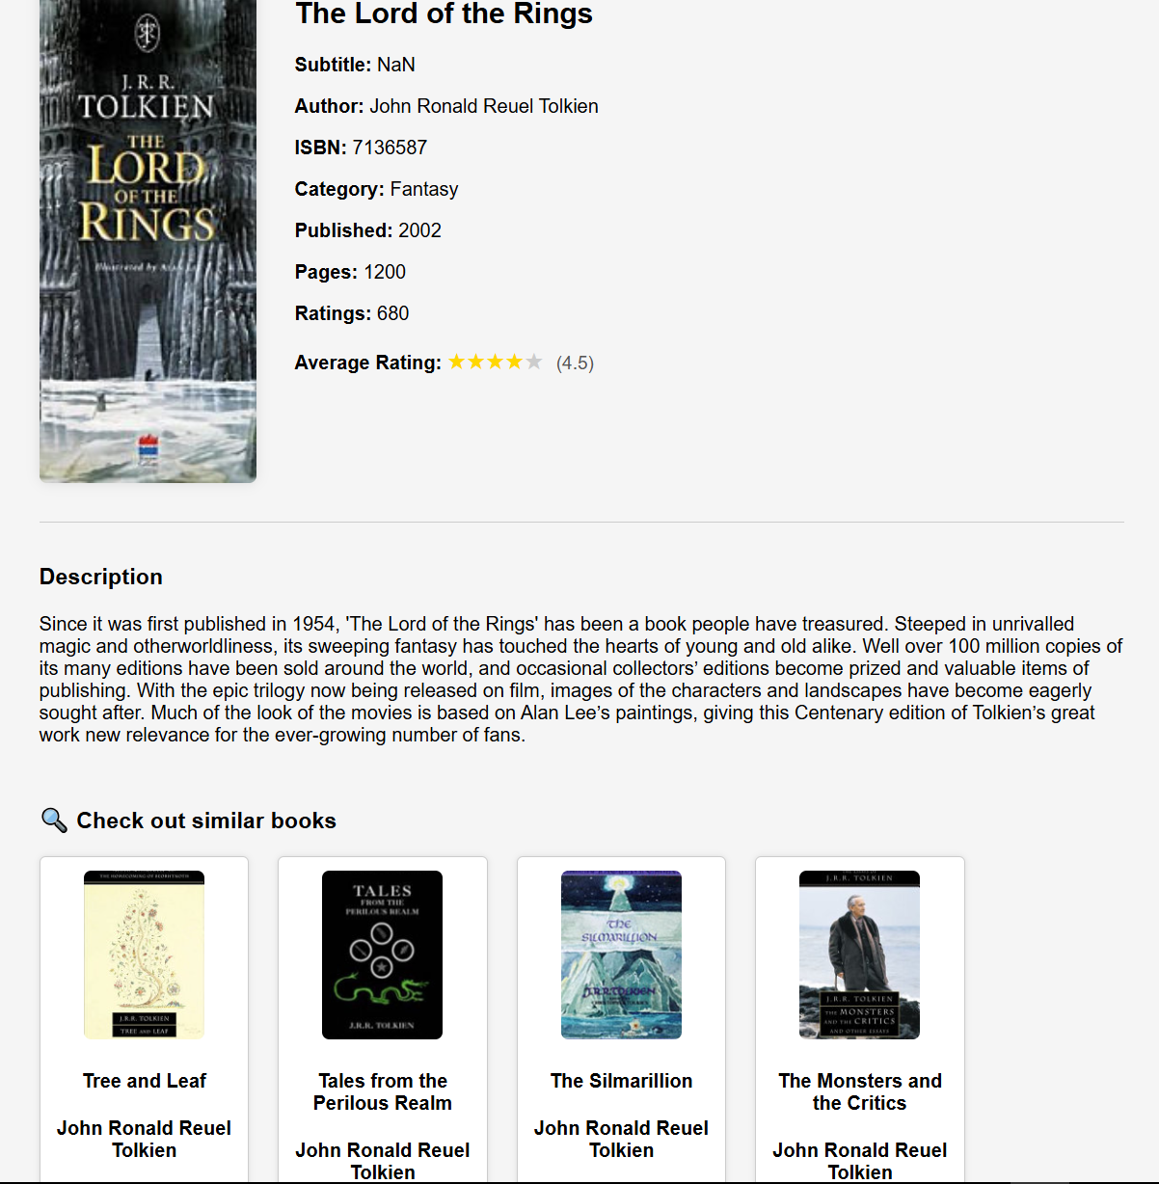
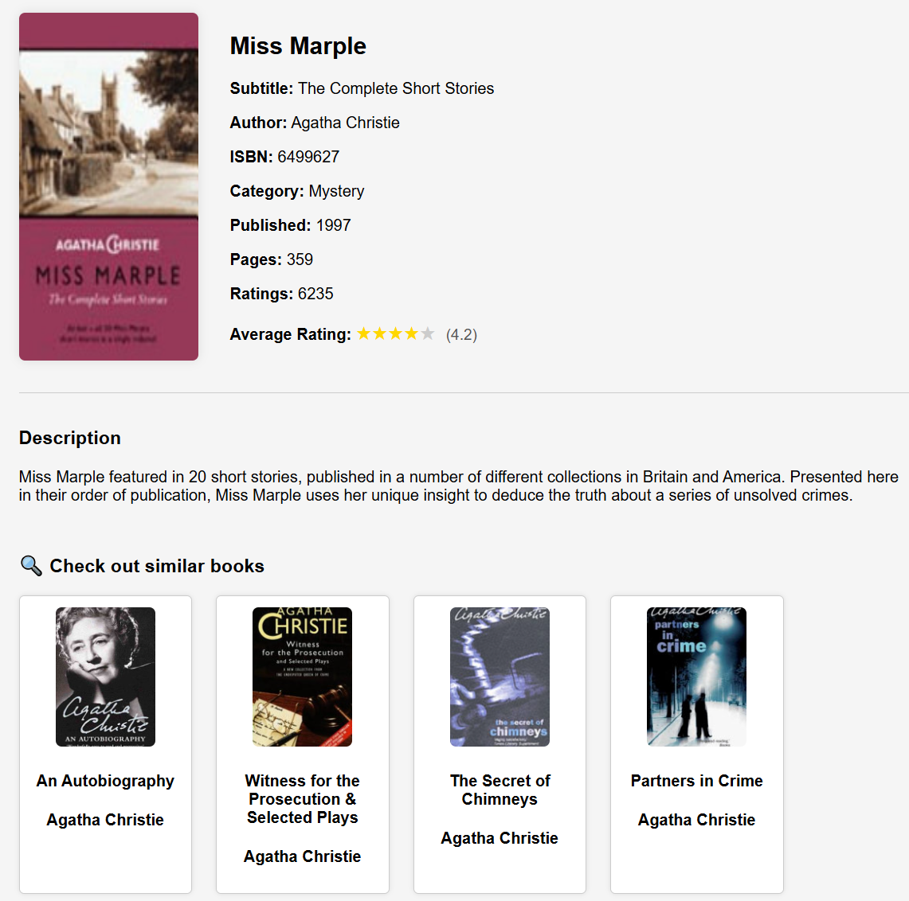
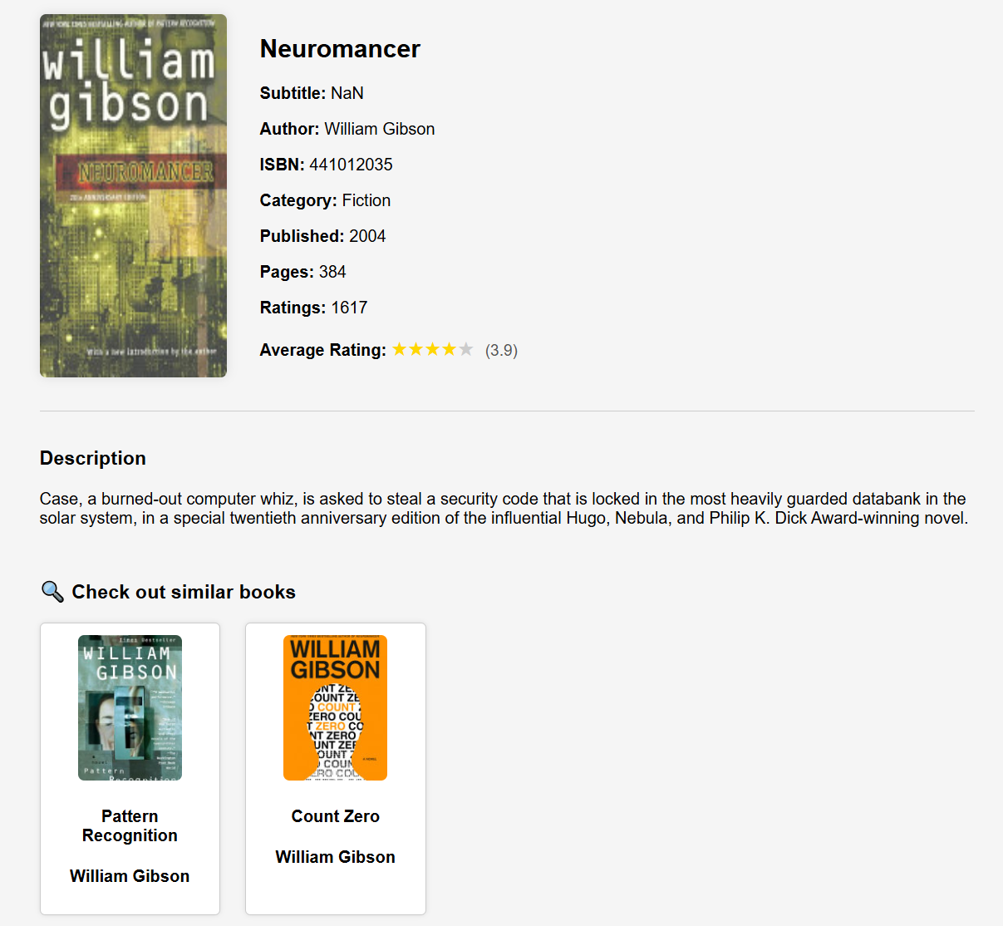
Book Page
The Book Page provides a short description of the subject of the book with some general information about the book and their average rating . Underneath, there are similar books ( show books by the same author or from the same genre ).

Slide 9
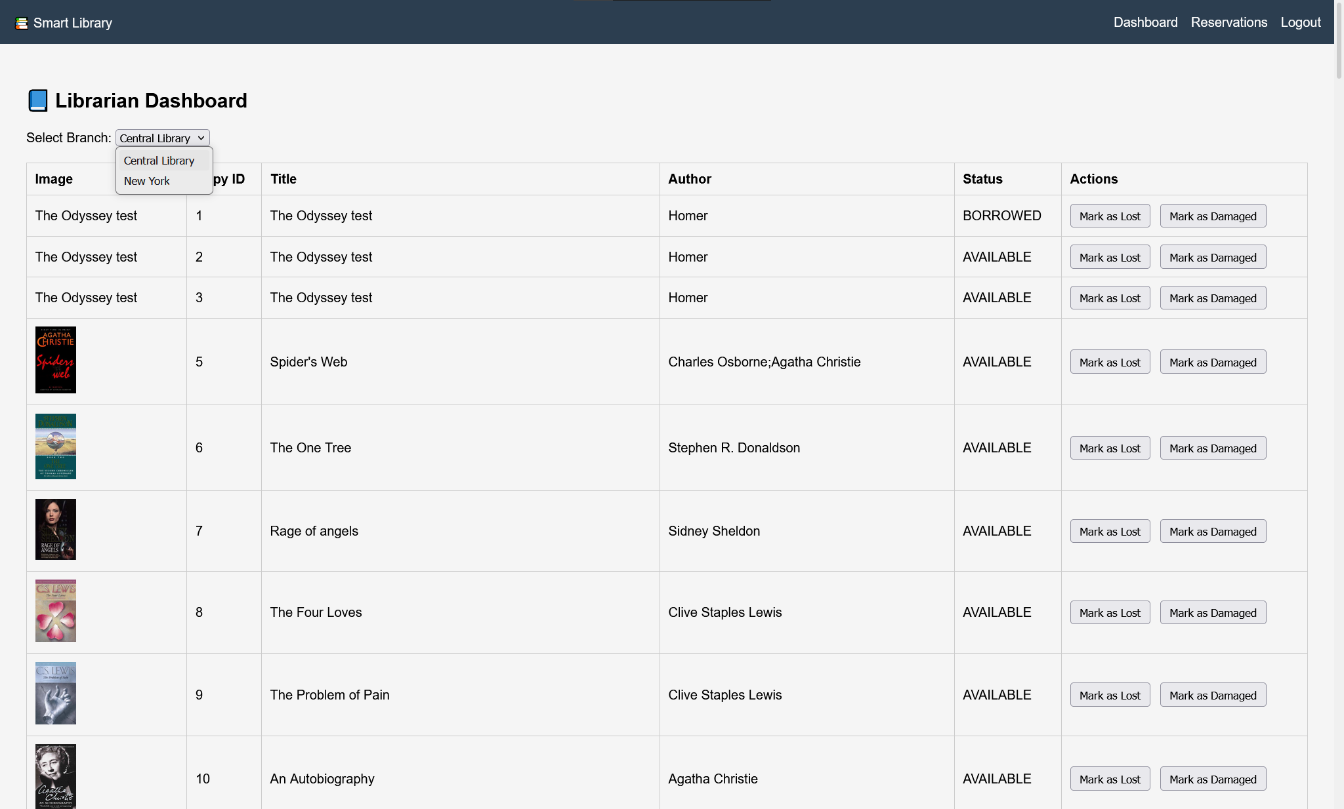
Librarian dashboard
Librarian dashboard provides a general overview of the physical copies of the books in the library and their state . The Librarian can also see the state of the book as Lost or Damaged and can see their status , Borrowed of Available .

Slide 10
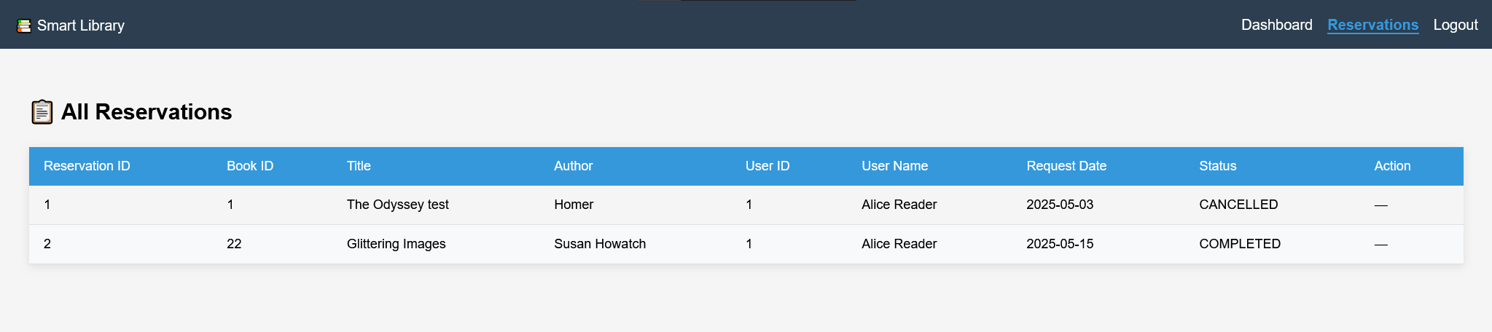
Reservations page
The reservations page for the librarian allows them to see current reservations and to whom they belong to .

Slide 11
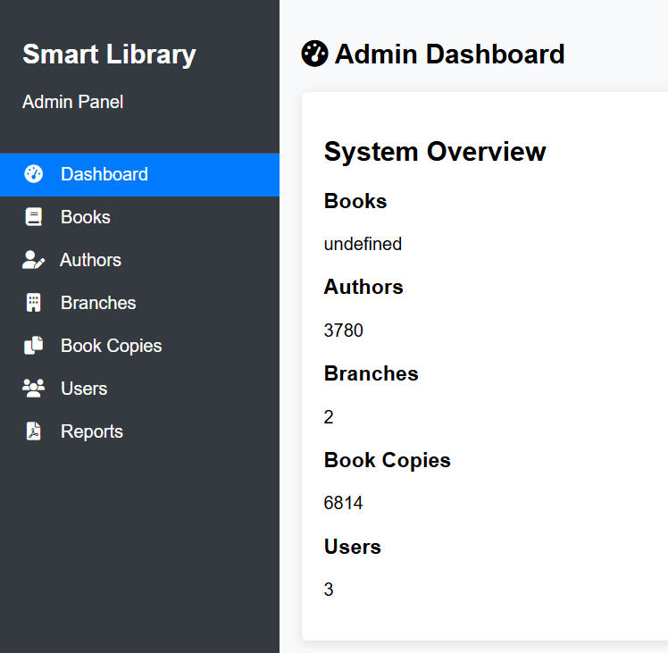
Admin Dashboard
The Admin dashboard present general information about the system like number of book copies , number of active branches and number of users .

Slide 12
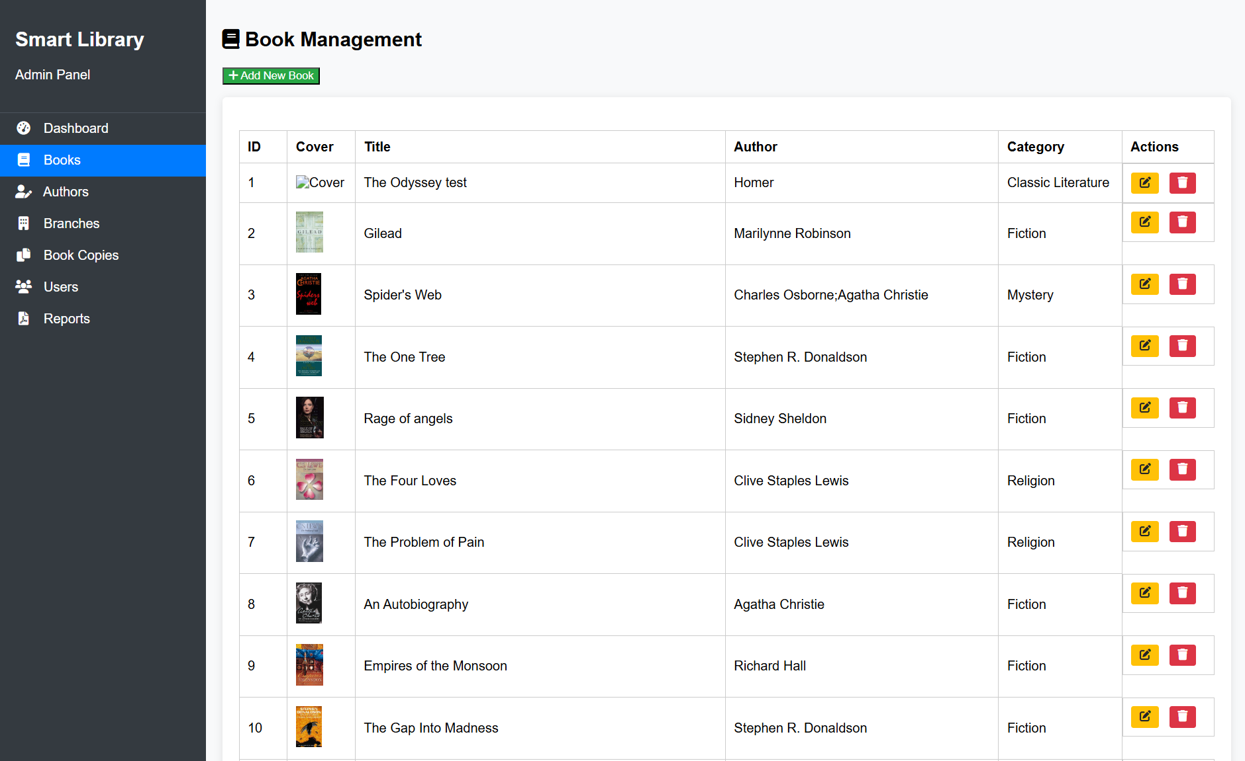
Book Management
Book Management allows the Administrator to add new books to the database. He can also delete or edit the existing books.

Slide 13
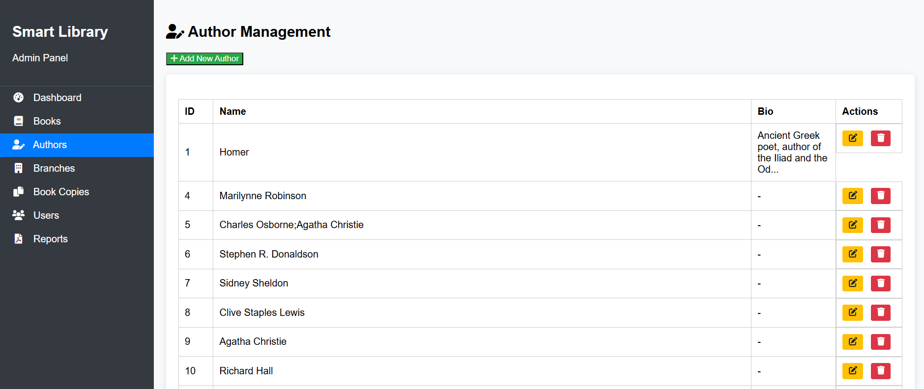
Author management
Author management allows the administrator to modify the information about the authors present in the database as well as add or delete them .

Slide 14
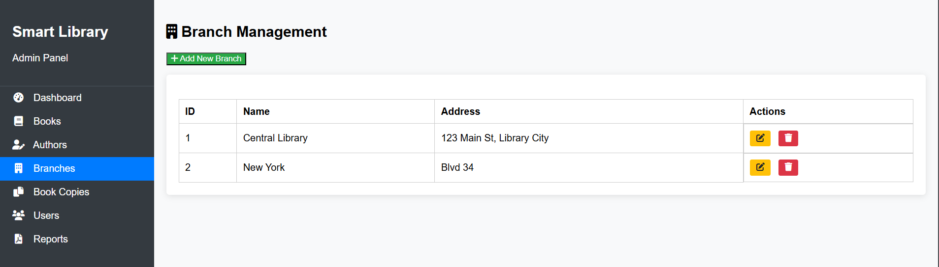
Branch Management
Branch Management allows the administrator to add new physical branches to the database and to modify the information for the other branches or delete them .

Slide 15
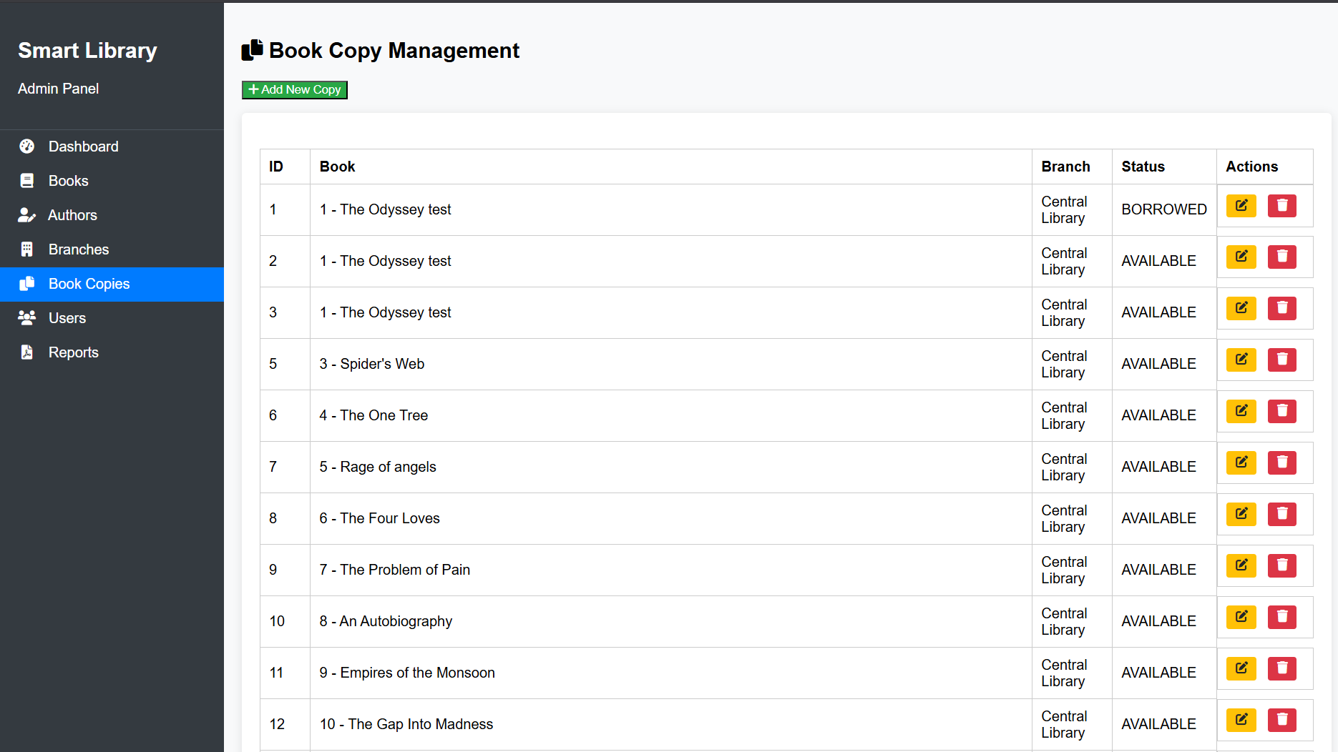
Book Copy Management
Book Copy Management allows the administrator to add new physical copies of the book newly arrived to our warehouses into the database as well as check their status or edit / delete them .

Slide 16
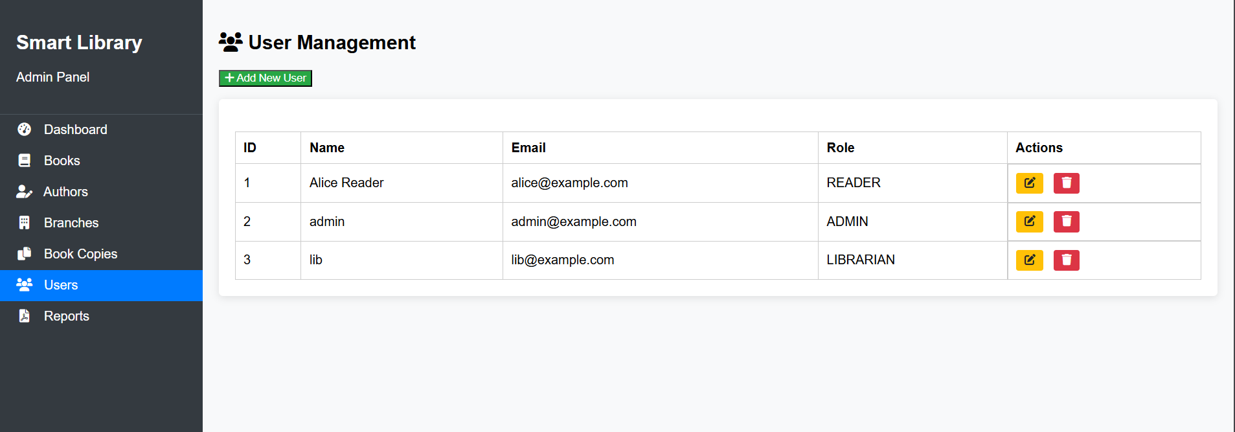
User Management
User Management allows the administrator to add new users or modify existing user profiles. He can also delete user profiles.

Slide 17
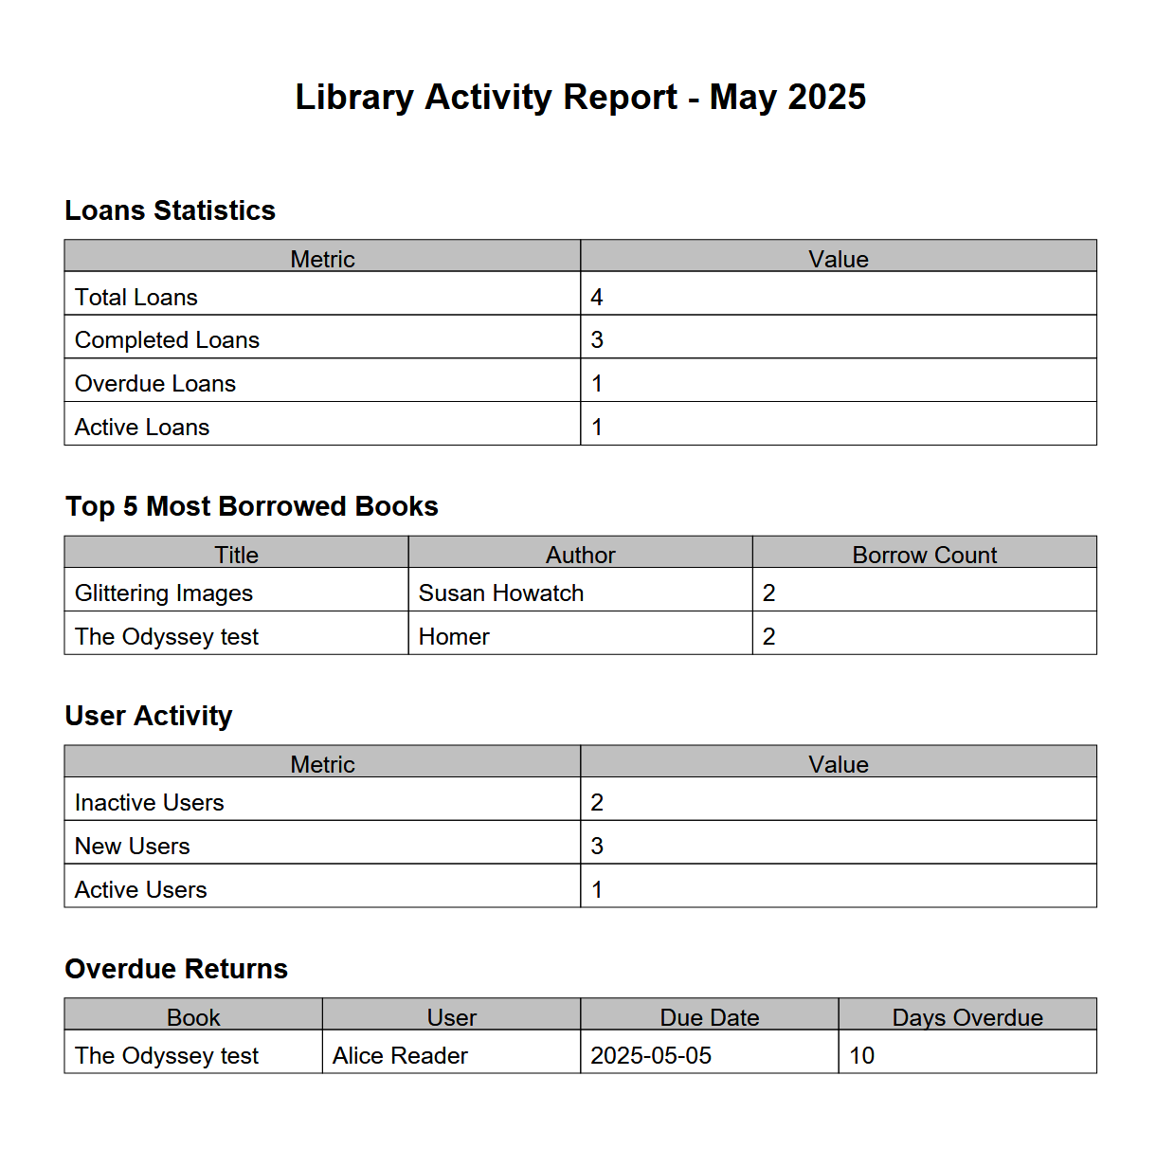
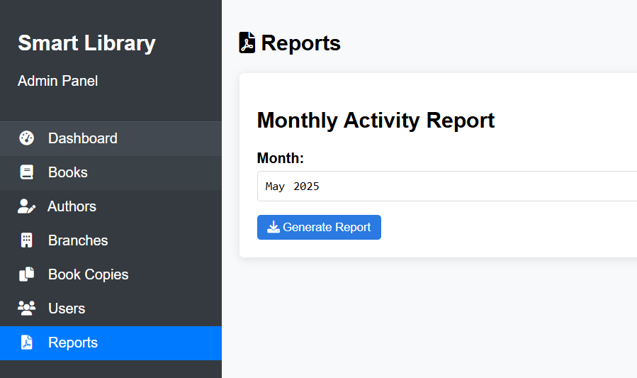
Reports page
The Reports page allows the administrator to generate monthly reports about library activity.

